Slide 1

ONLINE ASSIGNMENT PLAGIARISM CHECKER https://github.com/Pavani-567/FINALREVIEW
Batch No: B-11 Project Guide:
Pavani.K (164G1A0567) Mr. T.V. Naga Jayudu, _{M.Tech.,(Ph.D)}
RajyaLakshmi.G (164G1A0573) Assistant Professor
Sruthi.A (164G1A05A5)
Tarakeshwar.S (164G1A05B1)
Srinivasa Ramanujan Institute of Technology
Department of Computer Science & Engineering

Slide 2
Contents
Introduction
Existing Systems
Proposed System
Abstract
Problem Statement
Module Description
Output Screens
Conclusion
References

Slide 3
Introduction
Plagiarism is defined as to take or theft some work and present it has one’s own work.
This plagiarism detector measures the similar text that matches and detects plagiarism.
Internet has changed the student’s life and also has changed their learning style. It allows the students to get deeper in the approach towards learning and making their task easier.
In this plagiarism checker software, user can register with their basic registration details and create a valid login id and password.
By using login id and password, students can login into their personal accounts and upload assignment file.

Slide 4
Existing Systems
During the survey it has been observed that the existing systems have lot of features that can be extended.
Plag Tracker is one of the existing system which will take text as input and compare with web content.
The present system cannot identify plagiarism from a non-online source.

Slide 5
Proposed System
We present the application mainly to check the plagiarism among the assignments of the students.
It will compare the assignment of each student with other students and display the percentage of plagiarism detected.
Our final goal is to make the faculty to identify the students who have copied and based on that they will validate whether it is acceptable or not.

Slide 6
Abstract
Plagiarism is one of the growing issues in academia. Academic staff faces difficulties in marking student’s assignments with higher degree of judgment and waste their valuable time for plagiarism detection. Here we mainly focus on building an effective, simple and fast tool for plagiarism detection on text based electronic assignments to minimize this issue and to help the academic staff in conducting proper evaluation of assignments.

Slide 7

Problem Statement
Identifying the Plagiarism among the documents is difficult as well as time consuming so the process should be automated by this it will reduces the time.

Slide 8
Student Module
Students can registered with valid details like user name, Full name, password, phone number, email-address, group and Year.
Students can able to upload the documents and they can edit the document text. Students can check their plagiarism report along with the status and plagiarism percentage.

Slide 9
Faculty Module
Faculty can view the system registered students.
Check the uploaded documents along with the parsed content. Faculty can able to plagiarized the document and calculate the percentage based on the following criteria.
Based on Group Users
Based on Year Users
Combination of both Group and Year
All Uploaded Documents

Slide 10
Algorithm
Step-1 :-Register into the application.
Step-2 :-After successful registration enter into application or else repeat Step-1.
Step-3 :-Before uploading Assignments the assignments should be preprocessed.
Step-4 :-Clustering and pre processing.
Step-5:- Cluster them into payloads.
Step-6:- Based on the payloads it will measures the similarity among the Assignments.
Step-7:- It will display the similarity scores among the Assignments.

Slide 11
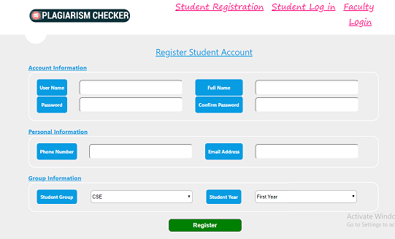
Student Registration

Slide 12
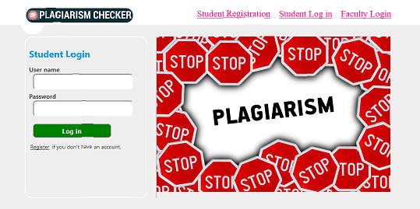
Student Login

Slide 13
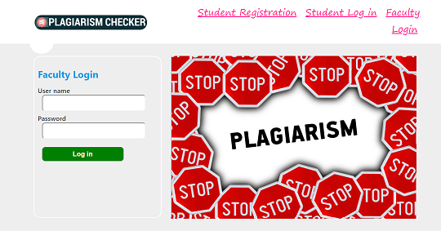
Faculty Login

Slide 14
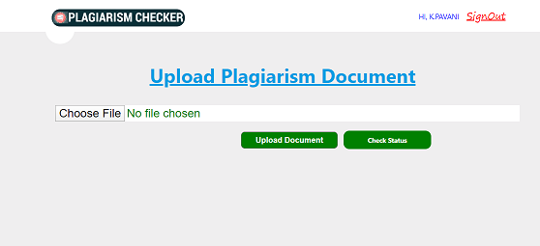
Upload their documents

Slide 15
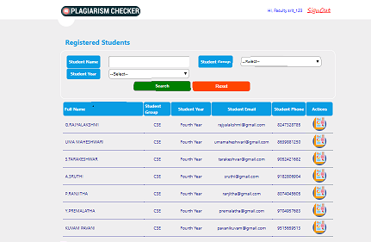
Faculty can view the uploaded documents

Slide 16
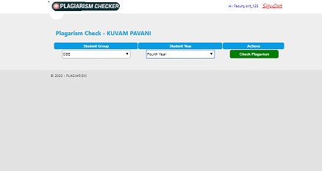
Checking Plagiarism

Slide 17
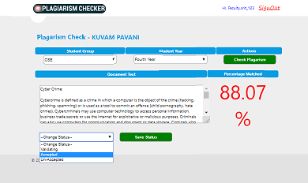
Percentage of plagiarized

Slide 18
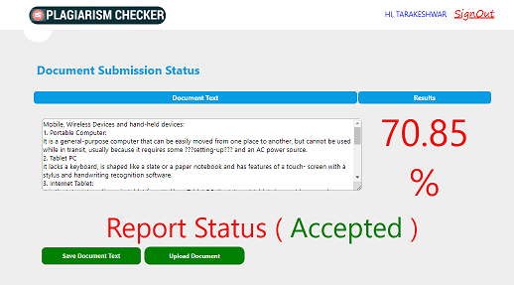
Checking Status

Slide 19
Conclusion
Manual verification of the Plagiarism is difficult as well as time consuming process, so the process should be automated, by this method it could be more efficient.
This application compares similarities among all documents and shows the plagiarism percentage, based on the allowable criteria set by the faculty. The faculty can validate whether the document is acceptable or unacceptable.

Slide 20
References
[1]Salha M.Alzahrani, Naomie salim, and Ajith Abraham. “Understanding plagiarism linguistic patterns, textual features, and detection methods”. IEEE, 2012.
[2]Asif Ekbal, Sriparna Saha, Gaurav Choudhary. “Plagiarism Detection in Text using Vector Space Model”. IEEE, 2012.
[3] MAC Jiffriya, MAC Akmal Jahan, Roshan G Ragel and Sampath Deegalla. “Anti-Plag: Plagiarism Detection on Electronic Submissions of Text Based Assignments”. IEEE, 2013.

Slide 21
THANK YOU
Queries
?

